Slide 1
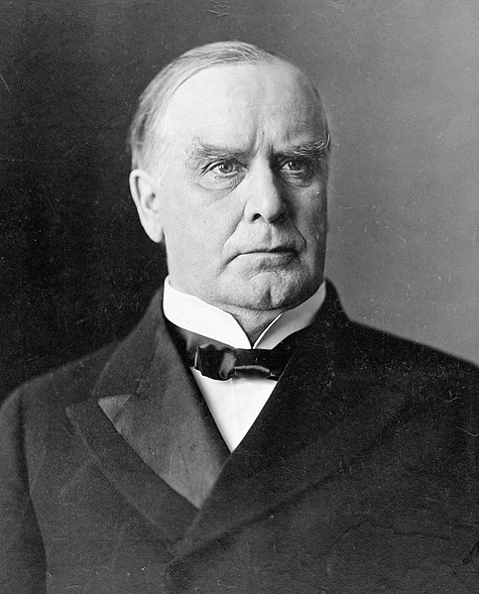
William McKinley

Slide 2
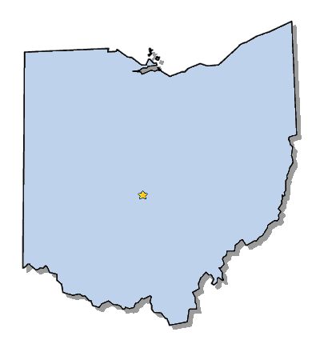
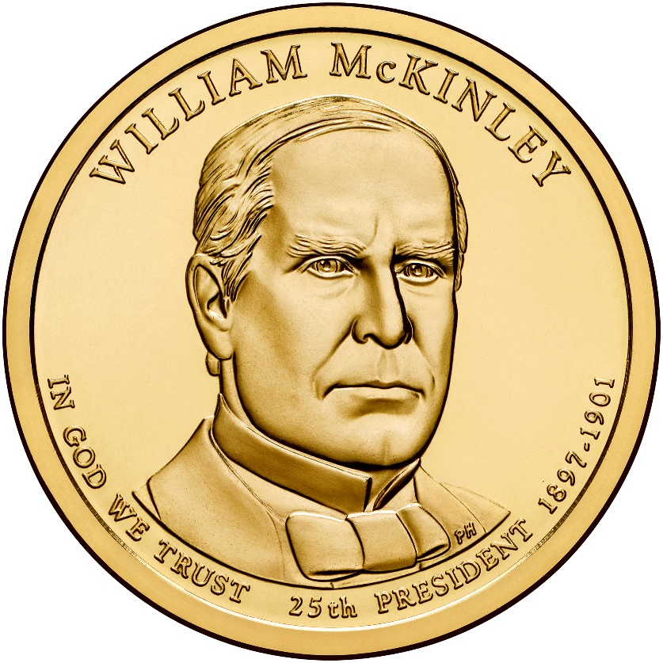
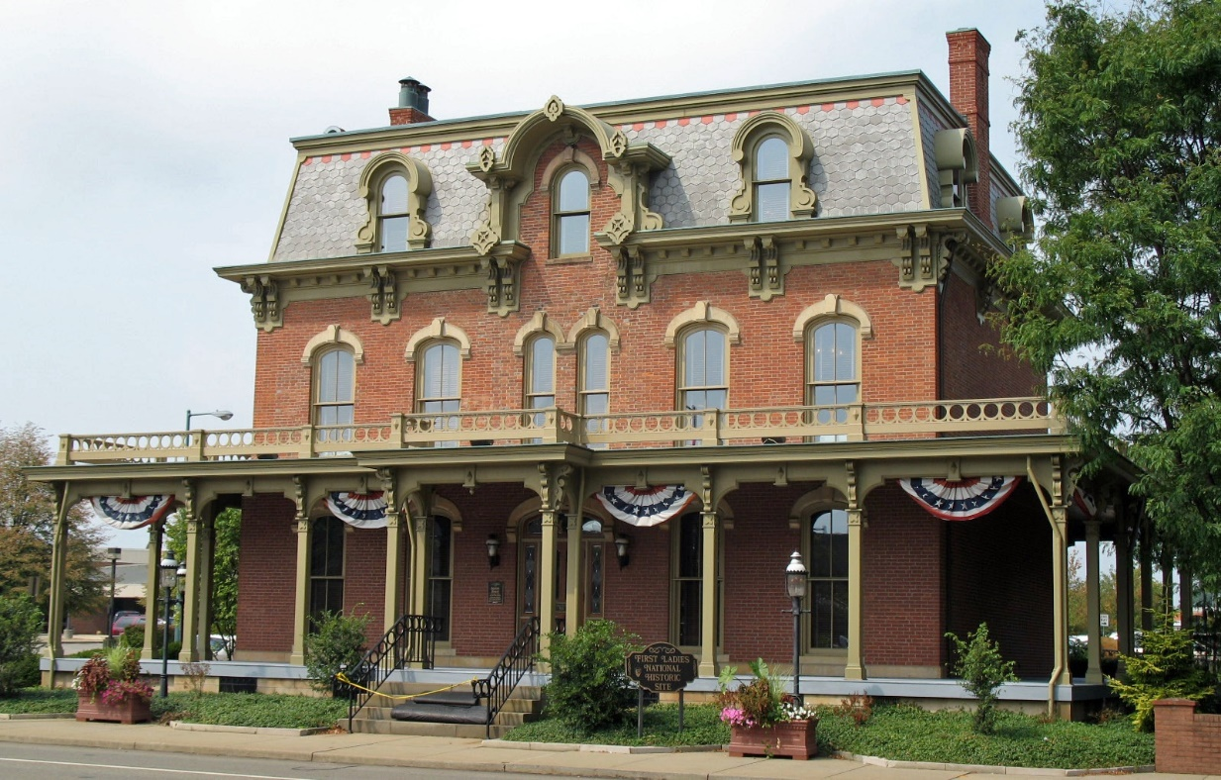
Elected in: 1896, 1900
President from: 1897 - 1901
Political Party: Republican
Home State: Ohio

Slide 3
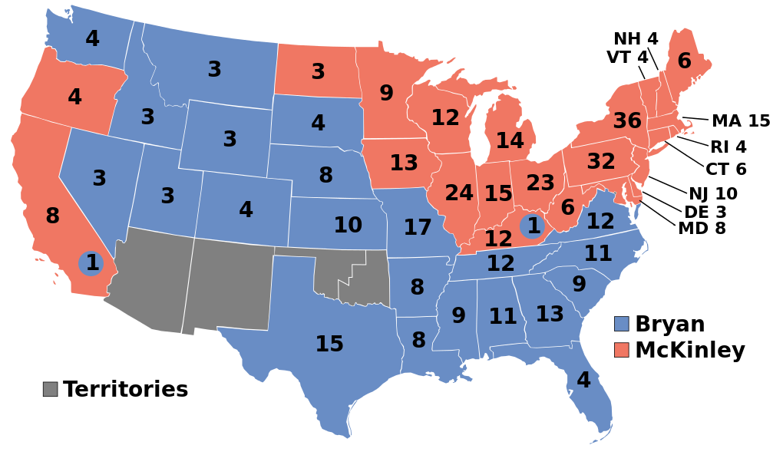
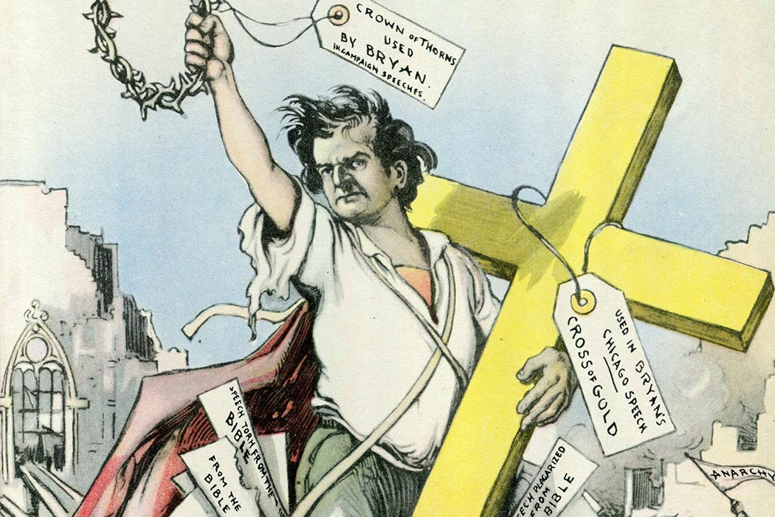
Election of 1896
Republican: 271
President: William McKinley
Vice President: Garret Hobart
Democratic: 176
President: William Jennings Bryan
Vice President: Arthur Sewall

Slide 4
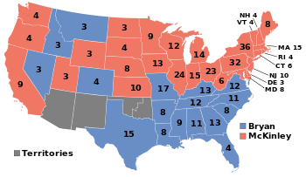
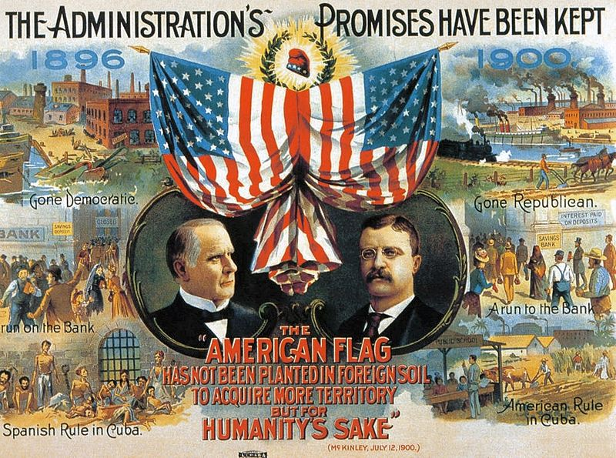
Election of 1900
Republican: 292
President: William McKinley
Vice President: Theodore Roosevelt
Democratic: 155
President: William Jennings Bryan
Vice President: Adlai Stevenson I

Slide 5
New States
None

Slide 6
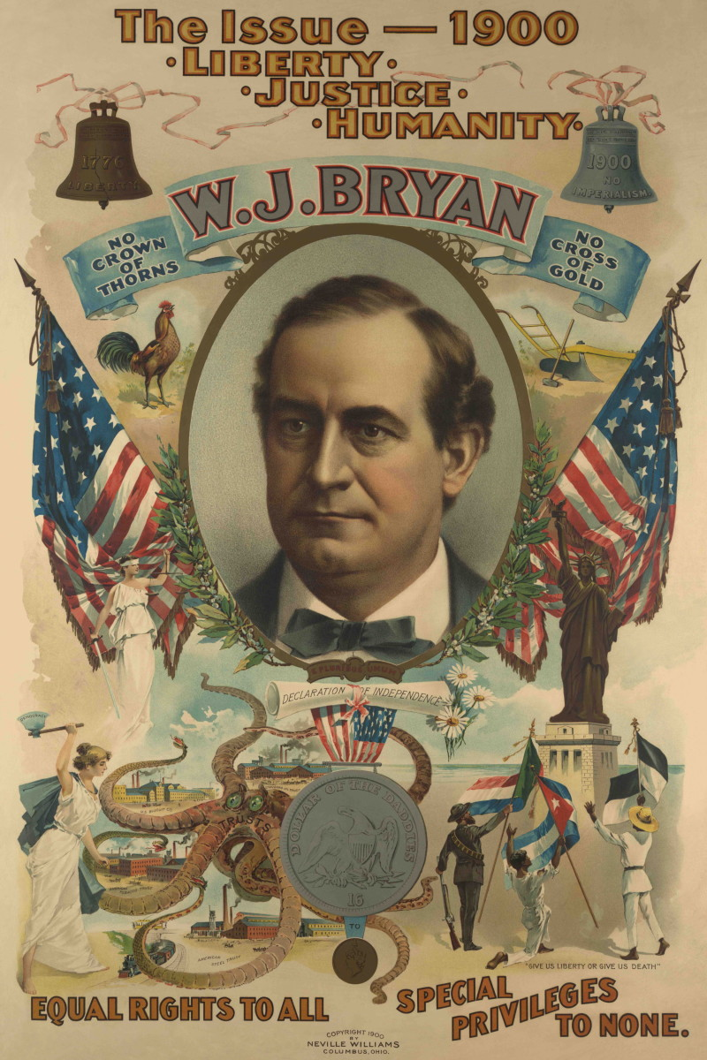
William Jennings Bryan
Midwesterner seen as a champion of progressive, liberal reforms
A brilliant orator and debater, who was in favor of “free silver” and against the gold standard.
Unsuccessfully ran for President as a Democrat in 1896, 1900, and 1908
Pushed for popular election of senators, income tax, creation of a Department of Labor, prohibition, and women’s suffrage.
Later becomes secretary of state and was involved in the “Scopes Monkey Trial”

Slide 7
There are two ideas of government. There are those who believe that, if you will only legislate to make the well-to-do prosperous, their prosperity will leak through on those below. The Democratic idea, however, has been that if you legislate to make the masses prosperous, their prosperity will find its way up through every class which rests upon them. You come to us and tell us that the great cities are in favor of the gold standard; we reply that the great cities rest upon our broad and fertile prairies. Burn down your cities and leave our farms, and your cities will spring up again as if by magic; but destroy our farms and the grass will grow in the streets of every city in the country.
It is the issue of 1776 over again. Our ancestors, when but three millions in number, had the courage to declare their political independence of every other nation; shall we, their descendants, when we have grown to seventy millions, declare that we are less independent than our forefathers? No, my friends, that will never be the verdict of our people. Therefore, we care not upon what lines the battle is fought. If they say bimetallism is good, but that we cannot have it until other nations help us, we reply that, instead of having a gold standard because England has, we will restore bimetallism, and then let England have bimetallism because the United States has it. If they dare to come out in the open field and defend the gold standard as a good thing, we will fight them to the uttermost.
Having behind us the producing masses of this nation and the world, supported by the commercial interests, the laboring interests, and the toilers everywhere, we will answer their demand for a gold standard by saying to them: "You shall not press down upon the brow of labor this crown of thorns; you shall not crucify mankind upon a cross of gold.”

Slide 8
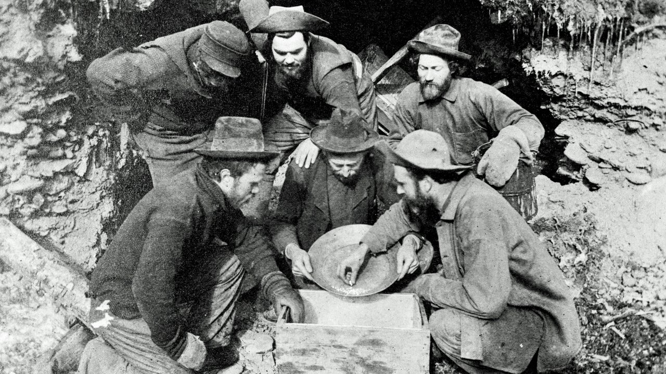
The Klondike Gold Rush
Gold discovered in Yukon territory of Canada in 1896
Best way for the 100,000 prospectors to get there was through Alaska- but fewer than 30,000 completed the trip
Very (less than 1%) actually grew rich

Slide 9
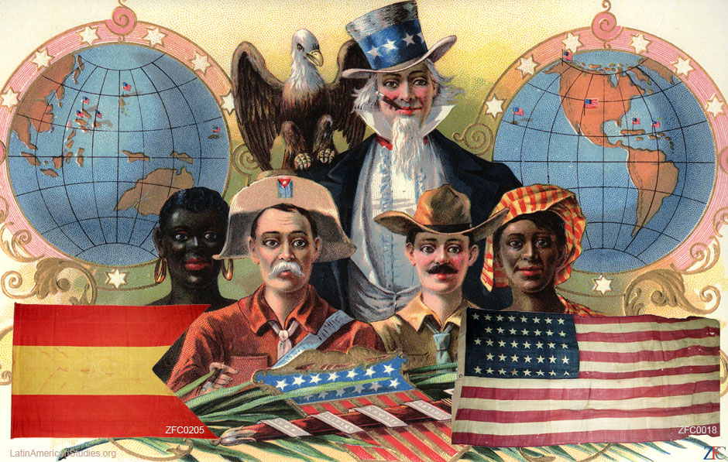
The Spanish – American War

Slide 10
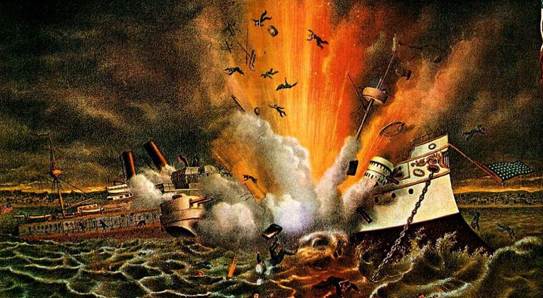
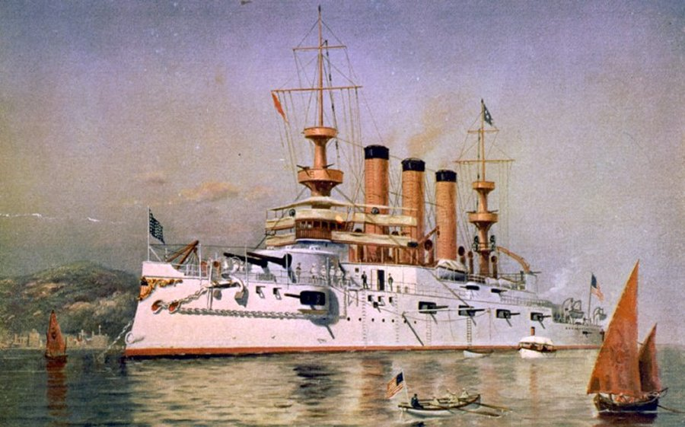
Remember the Maine!
To Hell with Spain!
Americans were sympathetic to rebels in Cuba fighting against Spanish rule.
McKinley send the USS Maine to Havana harbor to protect US interests
The USS Maine explodes in February 1898, killing 266. The US blames Spain, Spain blames an internal explosion.
McKinley calls for volunteers, and war is declared in April.

Slide 11
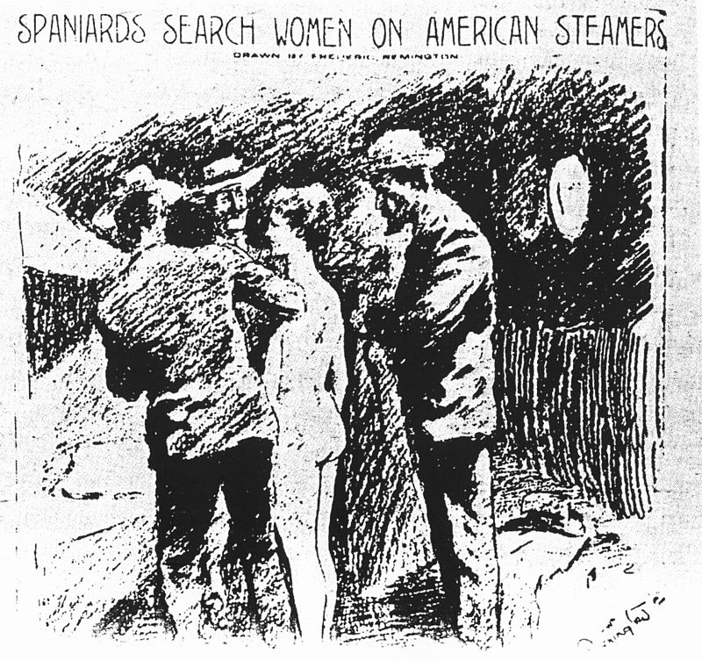
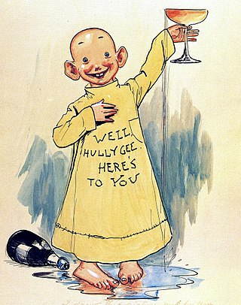
Yellow Journalism
Newspapers that use sensationalized stories or made-up “news” to sway popular opinion and sell more newspapers.
Named for “The Yellow Kid” comic
Among the worst offenders in 1900s America were Joseph Pulitzer’s New York World and William Randolph Hearst's San Francisco Examiner and New York Journal.
”You furnish the pictures and I'll furnish the war.”

Slide 12
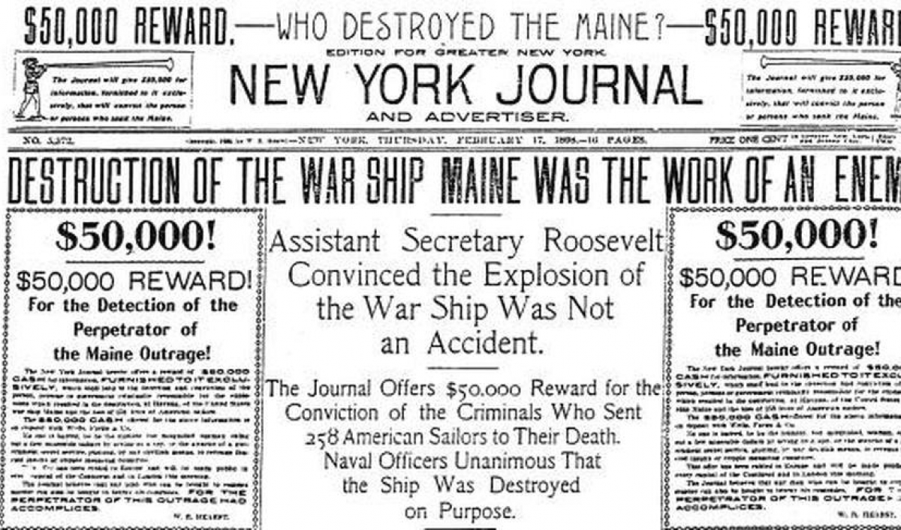

Slide 13
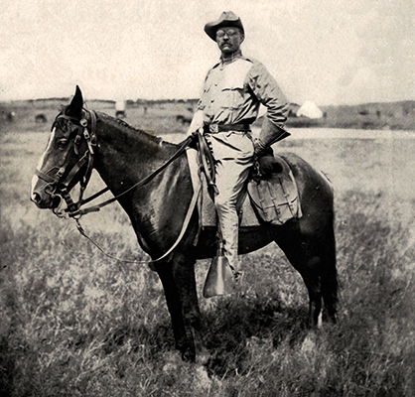
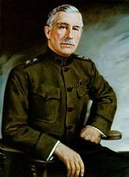
Lt. Colonel Theodore Roosevelt
Ass’t Secretary of the Navy who resigned to serve in the volunteer cavalry , “The Rough Riders”
Rough Riders made up of cowboys from the west and elite easterners
Easily earns the most fame during the Spanish American War
The real commander was Colonel Leonard Wood, from Winchester NH

Slide 14
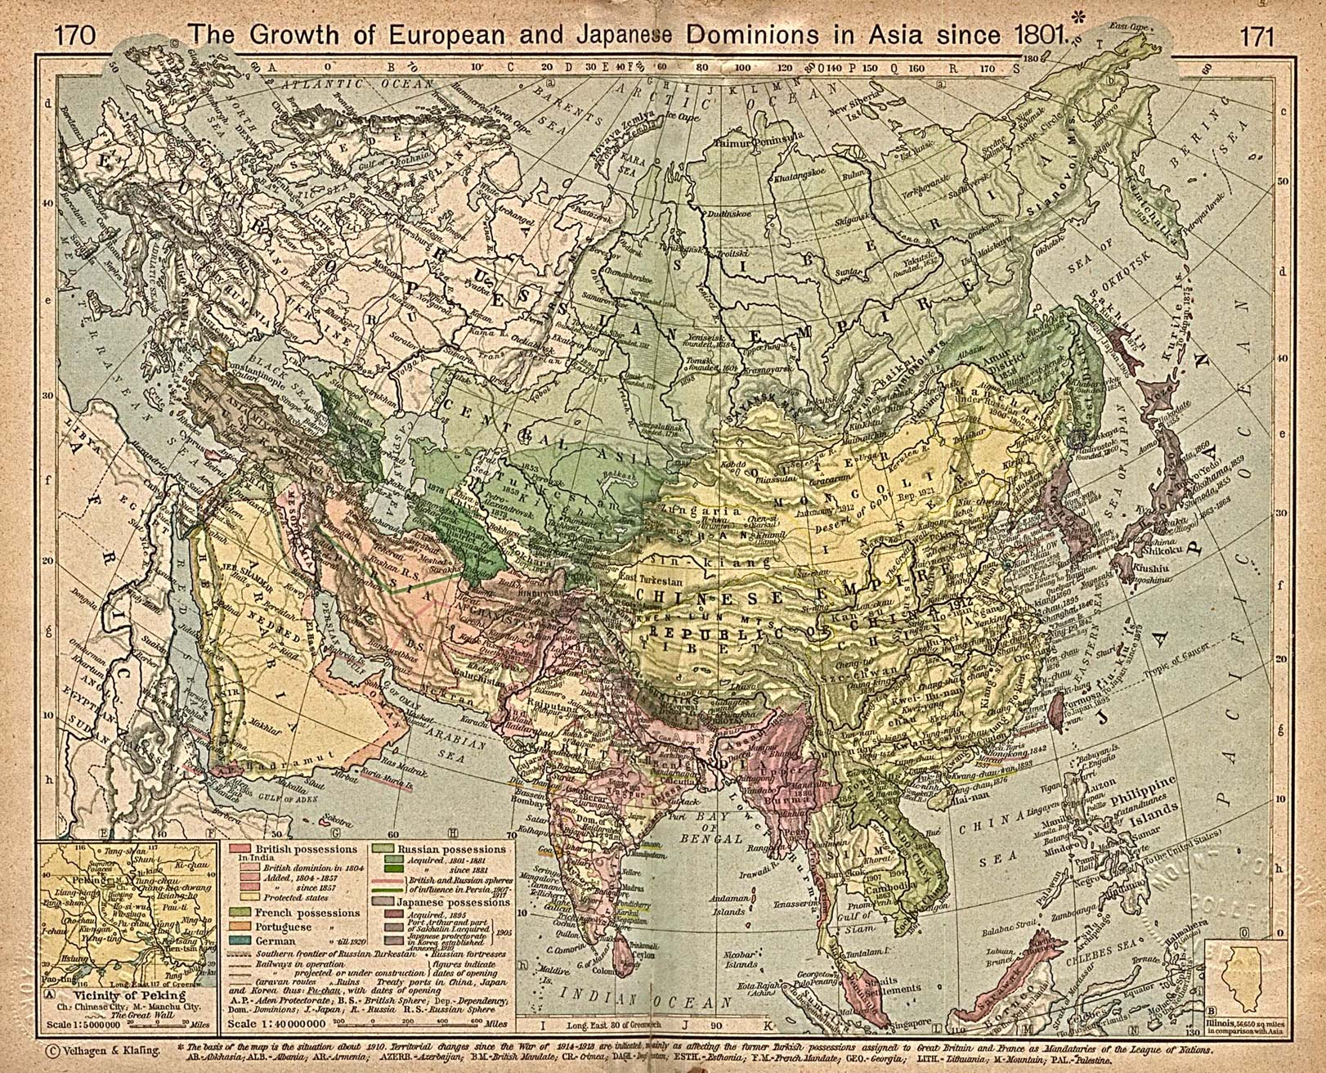
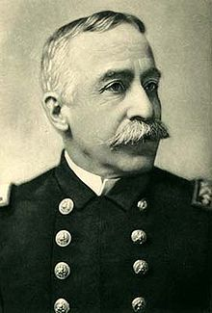
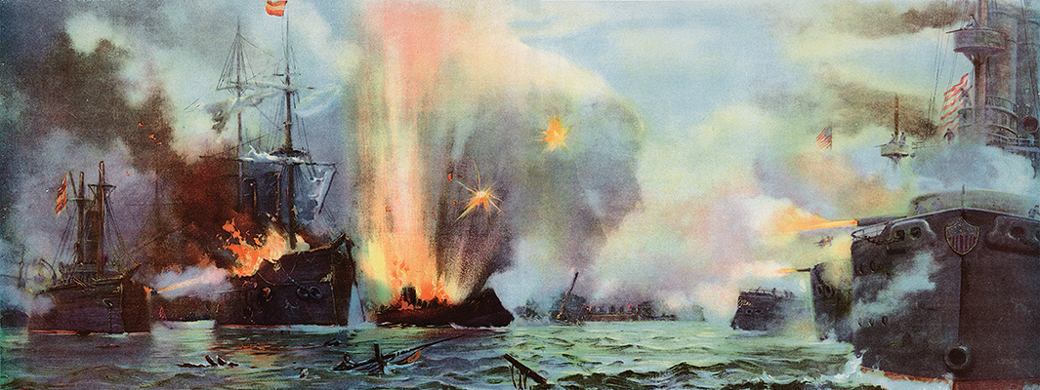
In June, US troops capture Guam Island
May: Admiral George Dewey’s navy squadron destroys Spanish Navy in Manila Bay, Philippines. US occupies Philippines by August.

Slide 15
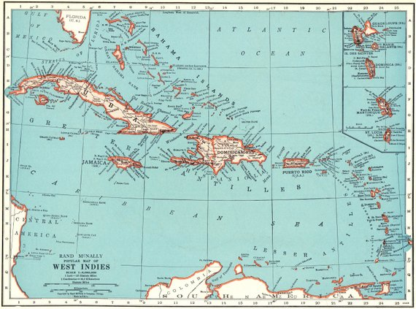
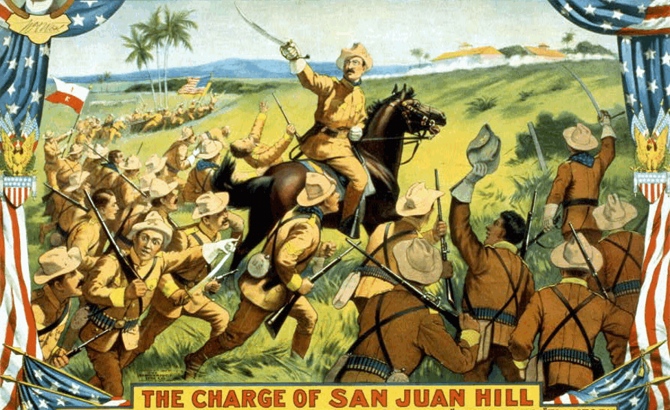
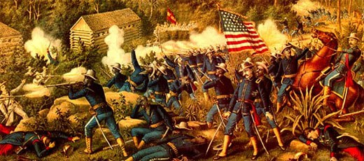
June – July: US invades Cuba. Lt. Col Theodore Roosevelt wins fame for leading his “Rough Riders” up San Juan Hill.
July: US forces liberate Puerto Rico

Slide 16
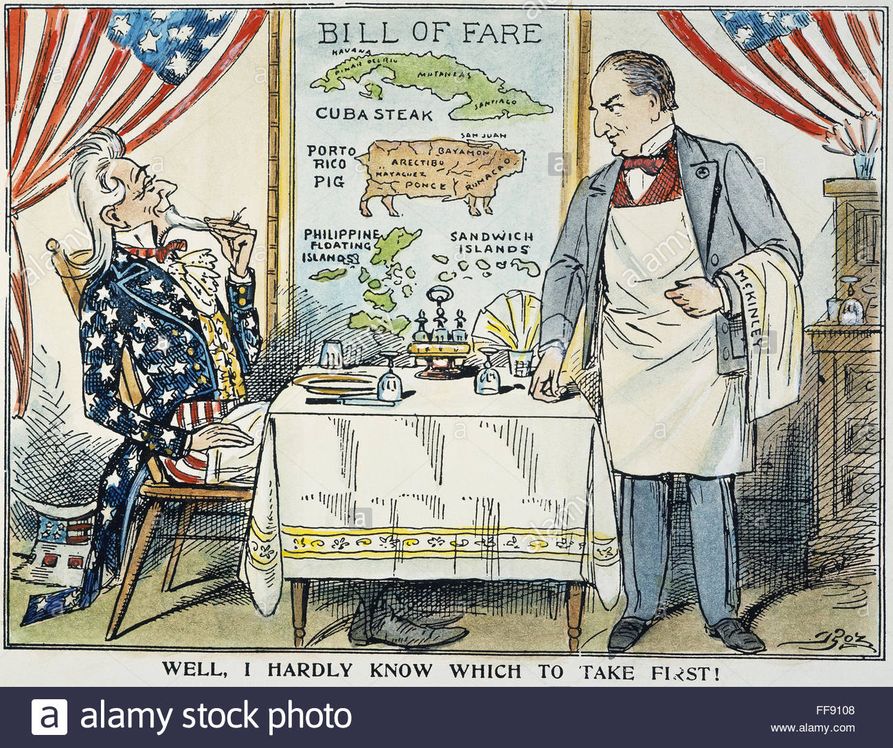
The Treaty of Paris - 1898
-Spanish ask for peace after 3 months of fighting
- US gets Puerto Rico, Guam, and the Philippines as colonies
-Cuba becomes an “independent” protectorate of the US (it becomes independent in 1902)
-US reserves, via the Platt Amendment, the right to intervene in Cuban affairs, and leases Guantanamo Bay forever.

Slide 17
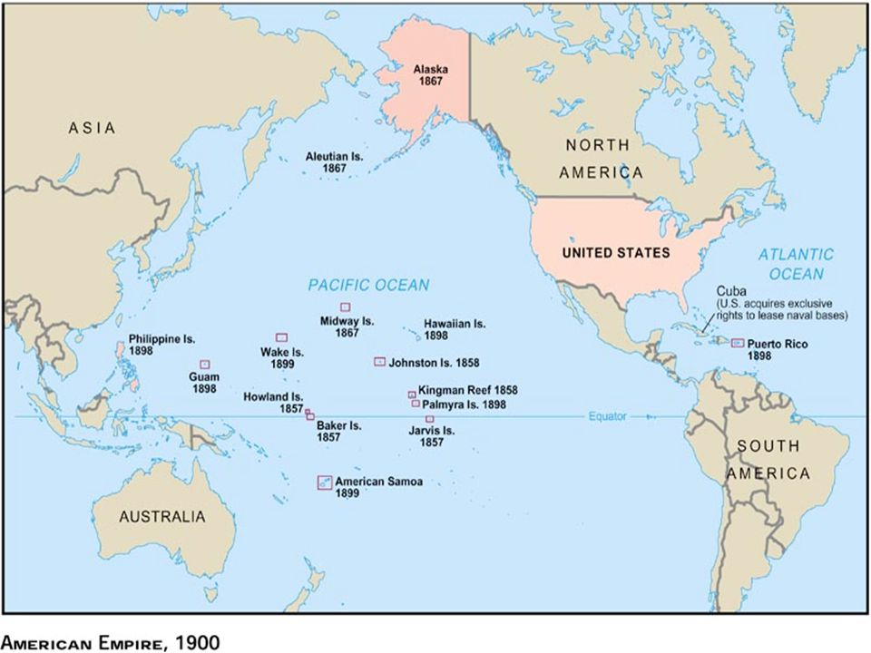

Slide 18
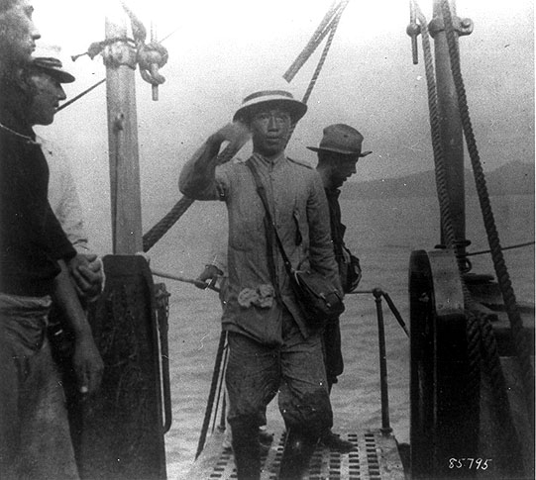
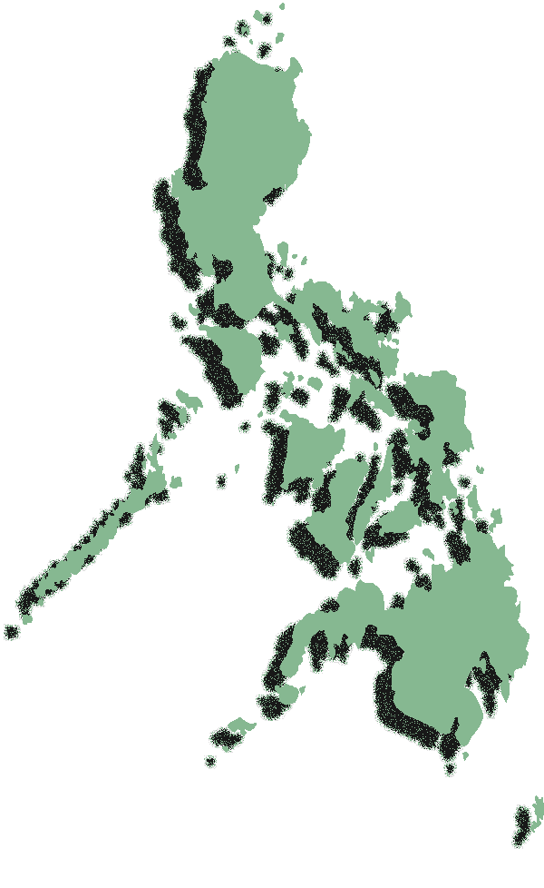
Emiliano Aguinaldo and the Philippine War
-Many Filipinos demanded independence after the Spanish-American War and were angry the US intended to keep the islands as a territory
-War broke out between occupying US troops and Filipinos – seen as an insurrection by the US, a war of independence by the Filipinos
-Emiliano Aguinaldo was a leader of the Filipino cause, and considered himself President of the First Filipino Republic. He was captured in 1902
-The wars lasted from 1899-1902, and resulted in between 4,000-6,000 American deaths, and between 200,000-1,000,000 Filipino deaths (mostly due to starvation and disease).
-US brought in teachers, built schools, and broke the power of the Catholic Church.
-The Philippines finally became independent in 1946.

Slide 19
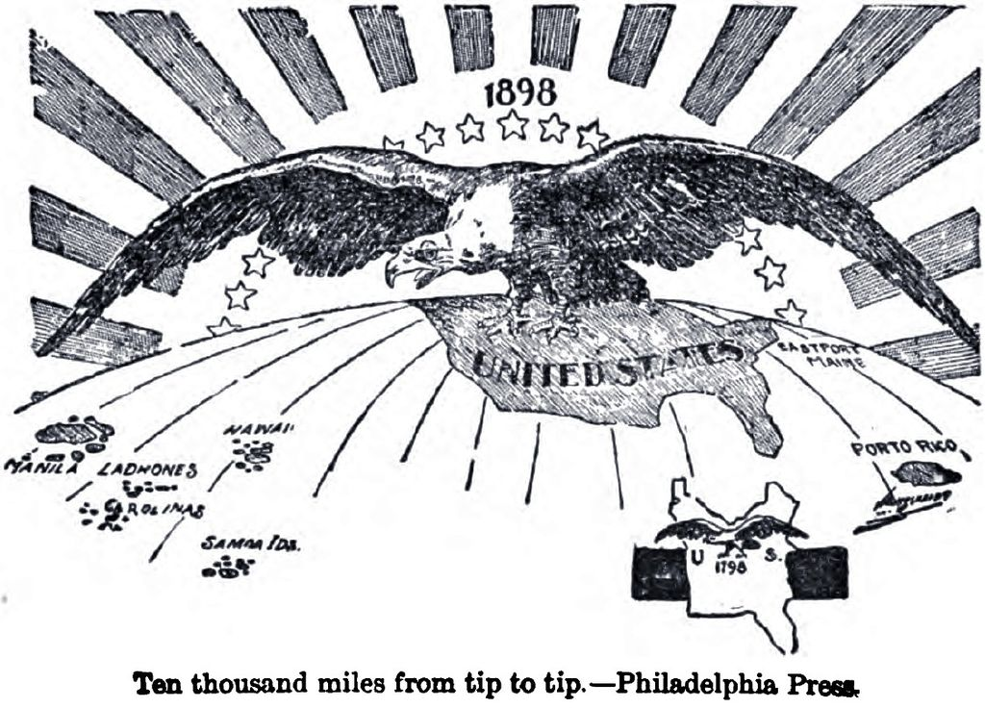
The Imperialism Debate
Is the United States the kind of country that should start colonies around the world?
Pro:
- The US needs the resources of other lands
- It will improve our military power
- The US is different: we don’t conquer for wealth, but to spread democracy and liberty
The other lands aren’t capable of governing themselves, we must civilize them
Our frontier is gone, we must expand to survive

Slide 20
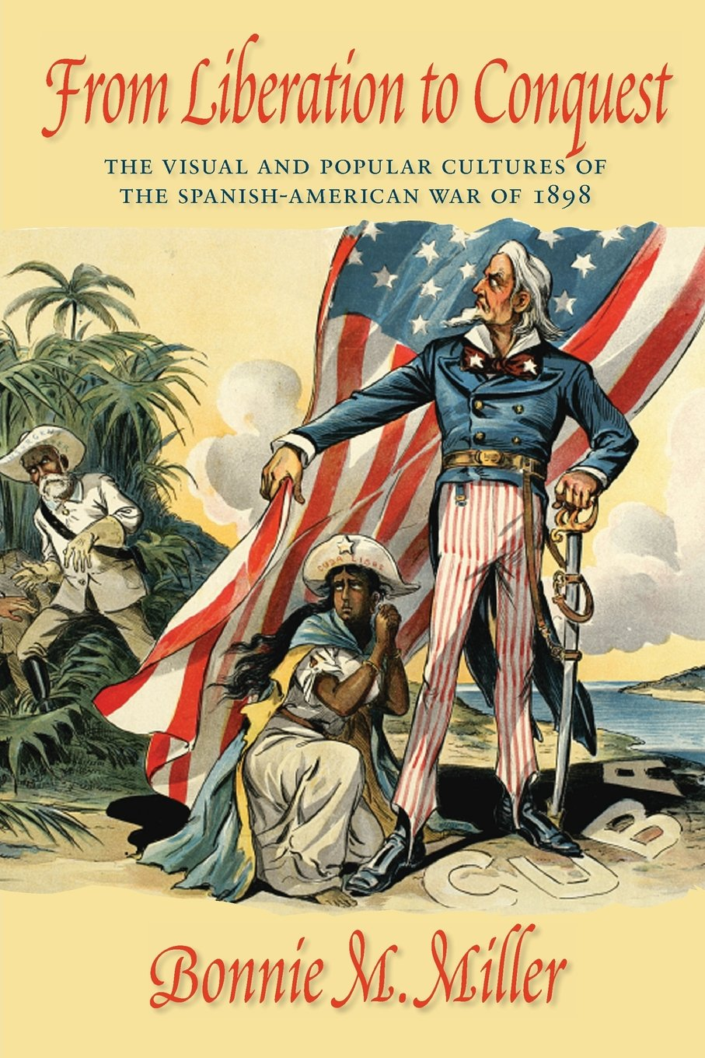

Slide 21
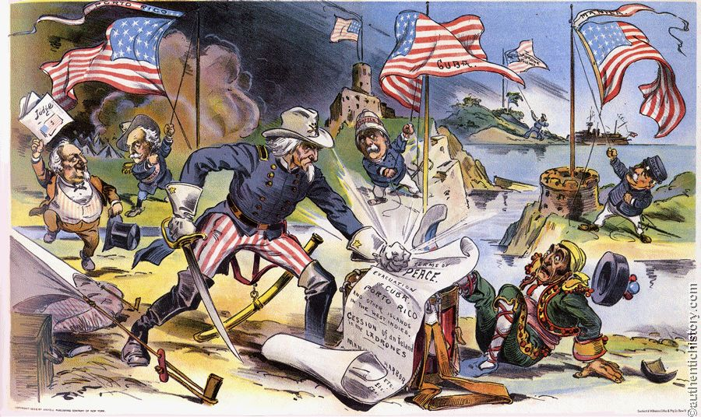

Slide 22
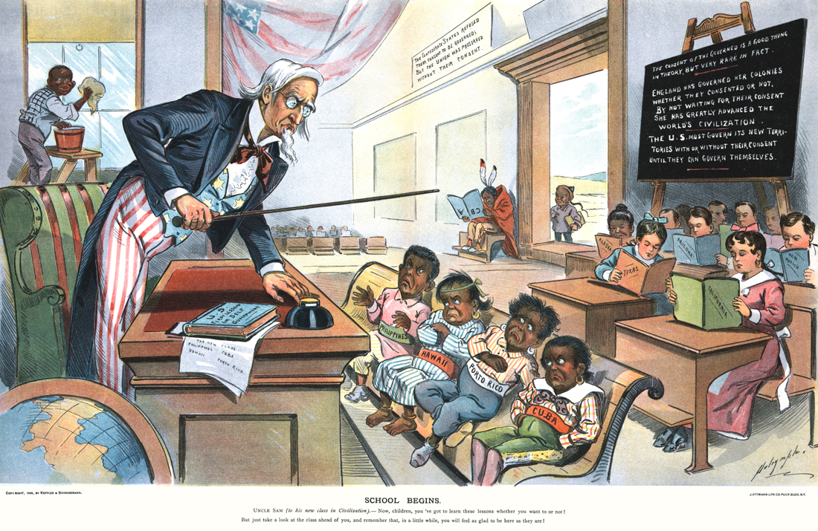

Slide 23
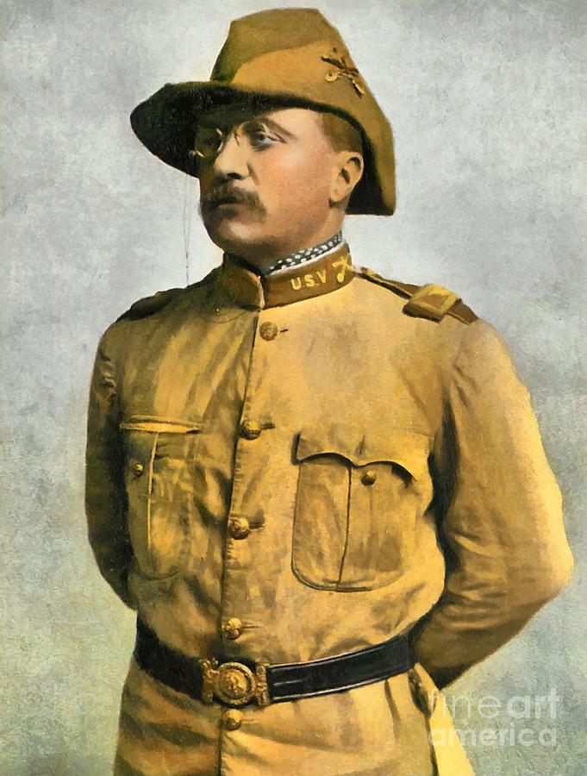
Pro-Imperialism
We cannot sit huddled within our own borders and avow ourselves merely an assemblage of well-to-do hucksters who care nothing for what happens beyond. Such a policy would defeat even its own end; for as the nations grow to have ever wider and wider interests, and are brought into closer and closer contact, if we are to hold our own in the struggle for naval and commercial supremacy, we must build up our Dower without our own borders.
-Theodore Roosevelt

Slide 24
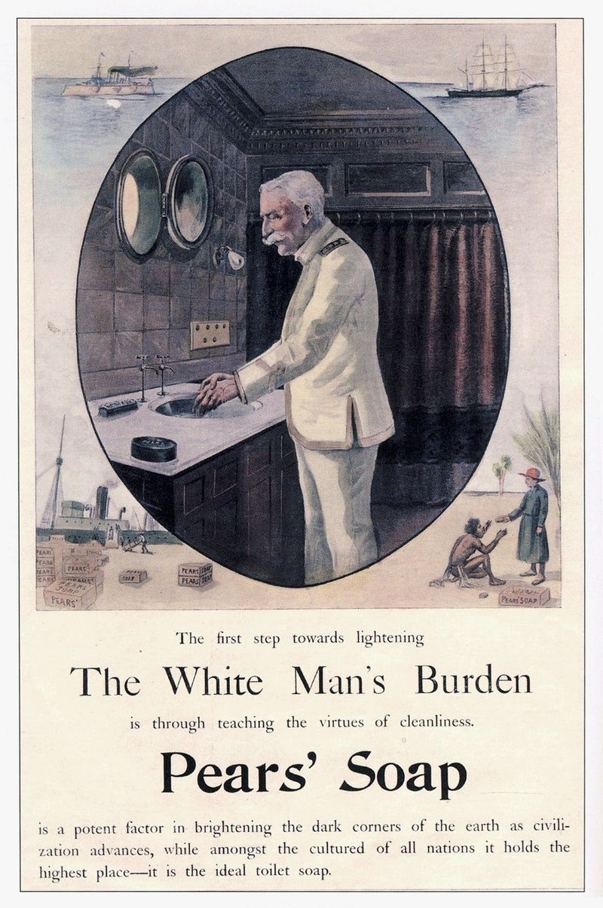
The White Man’s Burden
Take up the White Man's burden — Send forth the best ye breed — Go bind your sons to exile To serve your captives' need; To wait in heavy harness, On fluttered folk and wild — Your new-caught, sullen peoples, Half-devil and half-child…
Take up the White Man's burden — The savage wars of peace — Fill full the mouth of Famine And bid the sickness cease; And when your goal is nearest The end for others sought, Watch sloth and heathen Folly Bring all your hopes to nought…
Take up the White Man's burden — Ye dare not stoop to less — Nor call too loud on Freedom To cloak your weariness; By all ye cry or whisper, By all ye leave or do, The silent, sullen peoples Shall weigh your gods and you.
Take up the White Man's burden — Have done with childish days — The lightly proffered laurel, The easy, ungrudged praise. Comes now, to search your manhood Through all the thankless years Cold, edged with dear-bought wisdom, The judgment of your peers!
-Rudyard Kipling

Slide 25
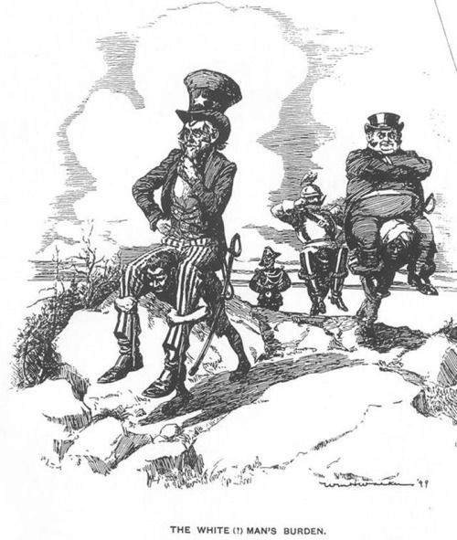
The Imperialism Debate
Is the United States the kind of country that should start colonies around the world?
Con:
- Violates the American belief in “government by the consent of the governed”
We were once a colony, we had no business colonizing others
Hostile to liberty, leads to militarism
- There was a limited amount of racism involved

Slide 26
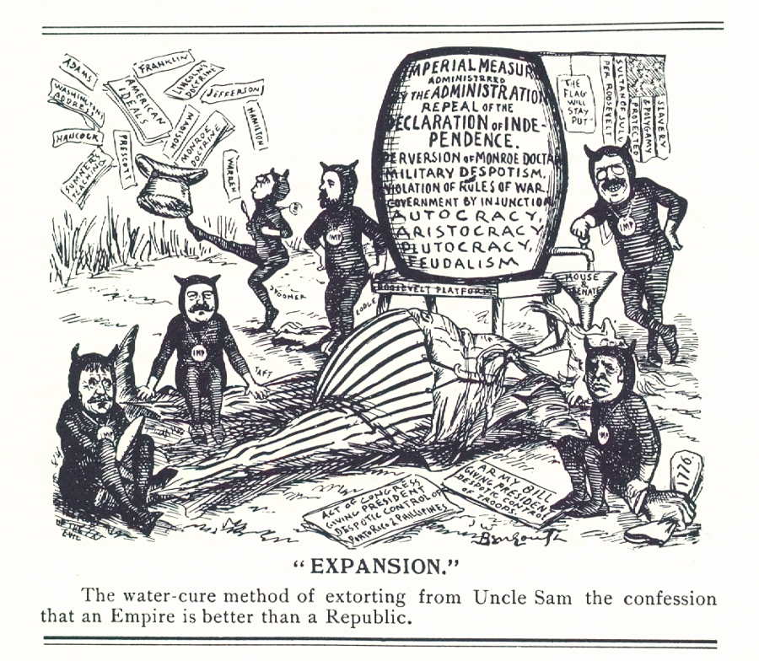

Slide 27
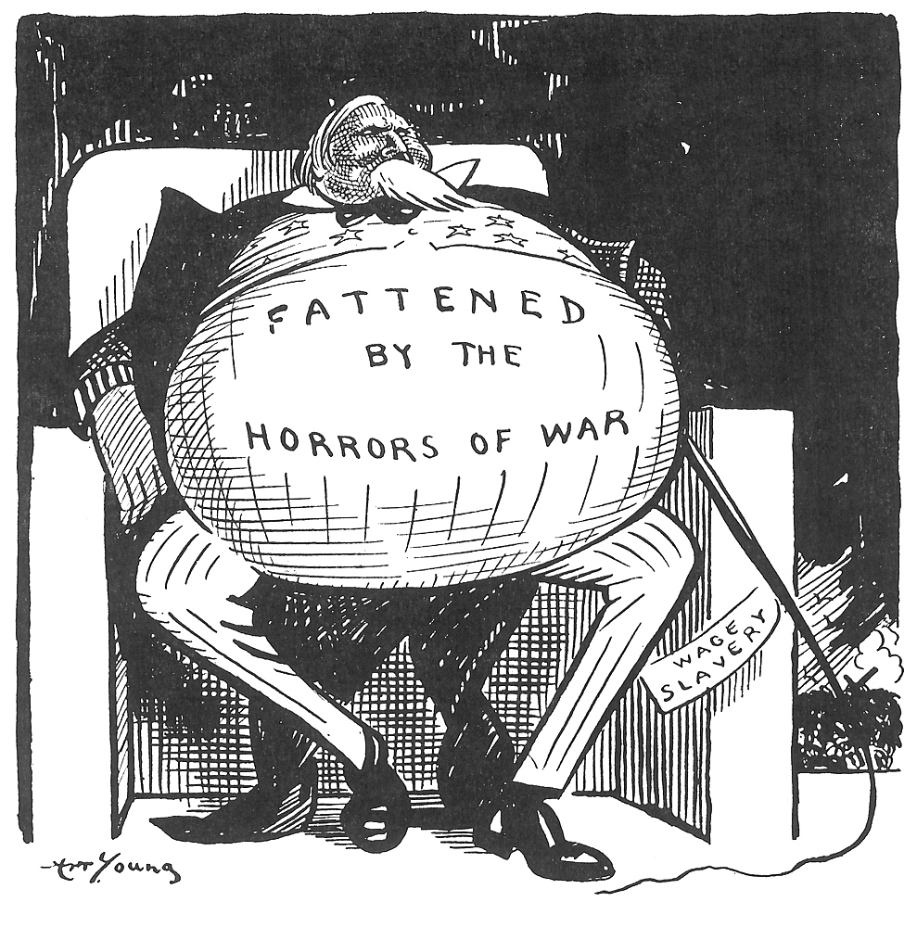

Slide 28
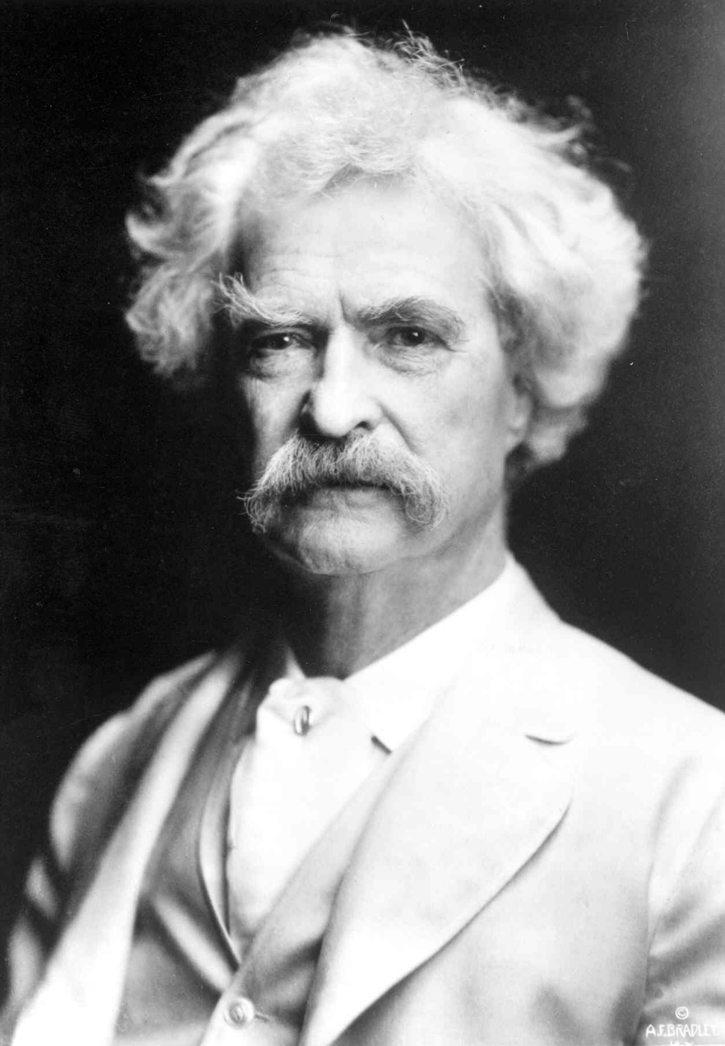
Anti-Imperialist View
I left these shores, at Vancouver, a red-hot imperialist. I wanted the American eagle to go screaming into the Pacific. It seemed tiresome and tame for it to content itself with the Rockies. Why not spread its wings over the Philippines, I asked myself? And I thought it would be a real good thing to do.
I said to myself, here are a people who have suffered for three centuries. We can make them as free as ourselves, give them a government and country of their own, put a miniature of the American constitution afloat in the Pacific, start a brand new republic to take its place among the free nations of the world. It seemed to me a great task to which we had addressed ourselves.
But I have thought some more, since then, and I have read carefully the treaty of Paris, and I have seen that we do not intend to free, but to subjugate the people of the Philippines. We have gone there to conquer, not to redeem. We have also pledged the power of this country to maintain and protect the abominable system established in the Philippines by the Friars.
It should, it seems to me, be our pleasure and duty to make those people free, and let them deal with their own domestic questions in their own way. And so I am an anti-imperialist. I am opposed to having the eagle put its talons on any other land.
– Mark Twain

Slide 29
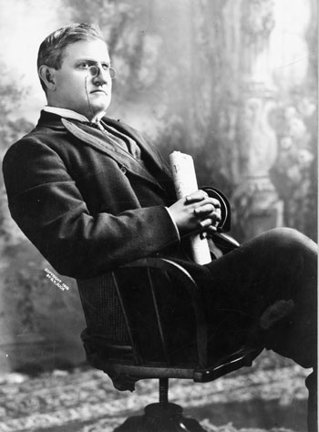
Anti-Imperialist View
We [Southern Democrats] understand and realize what it is to have two races side by side that can not mix or mingle without deterioration and injury to both and the ultimate destruction of the civilization of the higher. We of the South have borne this white man’s burden of a colored race in our midst since their emancipation and before. It was a burden upon our manhood and our ideas of liberty before they were emancipated. It is still a burden, although they have been granted the franchise. It clings to us like the shirt of Nessus, and we are not responsible, because we inherited it, and your fathers as well as ours are responsible for the presence amongst us of that people. Why do we as a people want to incorporate into our citizenship ten millions more of different or of differing races, three or four of them?...
Those peoples are not suited to our institutions. They are not ready for liberty as we understand it. They do not want it. Why are we bent on forcing upon them a civilization not suited to them and which only means in their view degradation and a loss of self-respect, which is worse than the loss of life itself?
-Senator Benjamin Tillman (D-South Carolina)

Slide 30
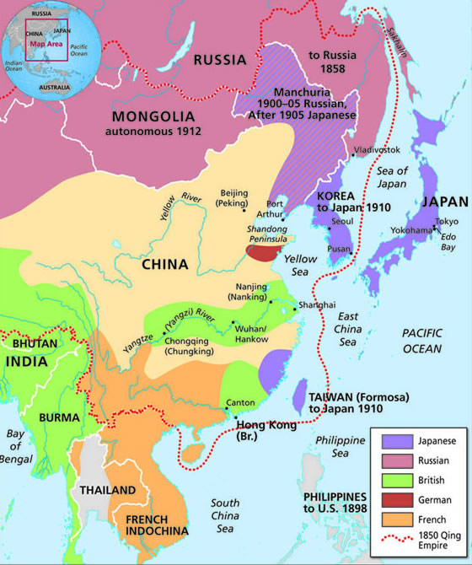
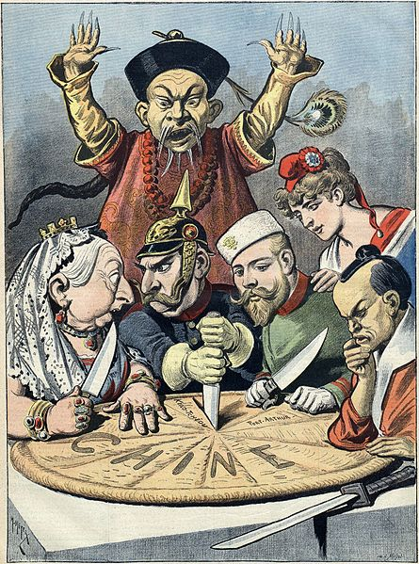
Hay Open Door Policy
Many European Powers (Britain, France, Germany, Russia, and also Japan) were dividing China into “spheres of influence.”
The US did not want to colonize China, but wanted to maintain trading rights within the nation
US Secretary of State John Hay proposed that all countries allow open access to the Chinese market, that China keep its independence, and the goal of the US was to keep China intact
All countries agree except Russia, but the Europeans dominate China for decades
Boxer Rebellion: Chinese rebels attempt to drive out or kill all non-Chinese. The “Boxers” are defeated by 20,000 troops from 8 nations (including the US).

Slide 31
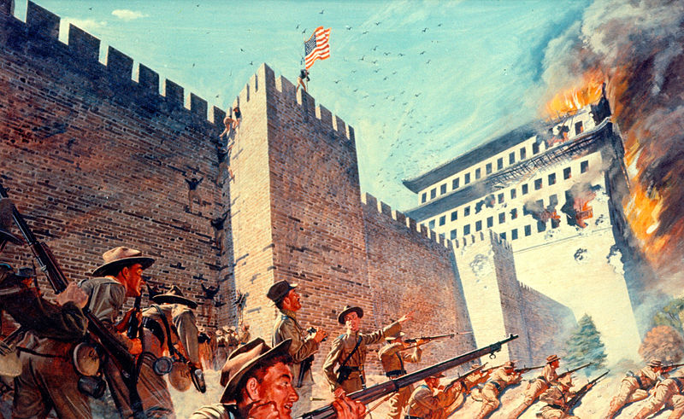

Slide 32
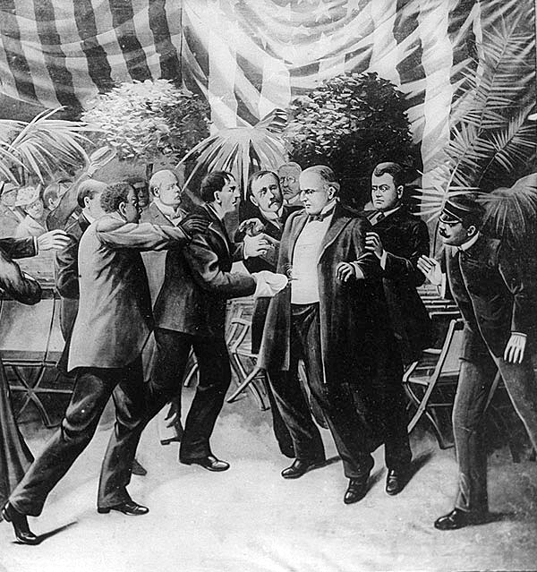
McKinley Assassinated
September 6, 1901: William McKinley is assassinated by Leon Czolgosz, an anarchist, in Buffalo NY
McKinley dies September 14.
Czolgosz is sent to the electric chair in October
Congress authorizes the Secret Service, the anti-counterfeit money agency, to protect the President in 1902.

